Slide 1

DEVSECOPS – THREAT MODELLING AND RISK ASSESSMENT FOR A SAMPLE APPLICATION

Slide 2


logistics
Class Hours:
Instructor will set class start and end times.
There will be regular breaks in class.
Telecommunication:
Turn off or set electronic devices to silent (not vibrate)
Reading or attending to devices can be distracting to other students
Try to delay until breaks or after class
Miscellaneous:
Courseware
Bathroom
Fire drills

Slide 3
INSTRUCTOR NAME

Slide 4

Introduce yourself
Time to introduce yourself:
Name
What is your role in the organization
Indicate DevSecOps experience

Slide 5
AGENDA & OBJECTIVES
Overview of DevSecOps and course objectives.
Introduction to threat modeling and risk assessment.
Definition, importance, and key principles (shift left, continuous monitoring, automation).
How threat modeling fits into DevSecOps workflows.
What is threat modeling? Goals and benefits.
Introduction to STRIDE (Spoofing, Tampering, Repudiation, Information Disclosure, Denial of Service, Elevation of Privilege) with examples. Overview of PASTA (Process for Attack Simulation and Threat Analysis) and comparison with STRIDE.
Tools for threat modeling, such as Microsoft Threat Modeling Tool (Microsoft Threat Modeling Tool).
Definition and components (assets, threats, vulnerabilities, controls).
Risk calculation (Risk = Likelihood × Impact) and methods (qualitative vs. quantitative).
Importance of prioritizing risks based on likelihood and impact.
Applying Threat Modeling to a sample application
Applying Risk Assessment to the sample application

Slide 6
Introduction to devsecops
What is DevSecOps?
Integration of security into the entire software development lifecycle, collaboration between development, security, and operations teams.
Why is DevSecOps important?
Early detection and resolution of security issues, reduced risk of breaches and vulnerabilities, improved efficiency and cost savings.
Key principles of DevSecOps:
Shift security left (integrate early in the development process), continuous monitoring and feedback, automation of security processes.
How threat modeling fits into DevSecOps:
Proactive identification of potential threats, helps in prioritizing security efforts.
Virtualization
Notes:
Explain that DevSecOps is not just about adding security steps but integrating security thinking throughout the development process. Emphasize that threat modeling helps in understanding potential security risks before they become actual problems, aligning with the shift-left principle. Highlight the importance of collaboration for effective security implementation.

Slide 7

What is threat modelling?
Definition: A structured approach to identify and assess potential threats to a system or application.
Goals:
Understand possible attack vectors
Prioritize security risks based on likelihood and impact
Design security controls to mitigate risks.
When to perform: Early in the design phase, throughout the development lifecycle as the system evolves.
Benefits:
Improves security posture by addressing vulnerabilities proactively
Enhances communication between stakeholders about security concerns.
Virtualization
Notes:
Threat modeling involves thinking like an attacker to find weaknesses in the system. It's iterative; as the system changes, the threat model should be updated. Discuss how early threat modeling can save costs and reduce risks compared to fixing issues post-deployment.
Address common misconceptions by giving examples of small applications benefiting from threat modeling, like a simple e-commerce site.
Common misconceptions: It's only for large systems or high-risk applications (but it's beneficial for all), it's a one-time activity (but it should be iterative).

Slide 8
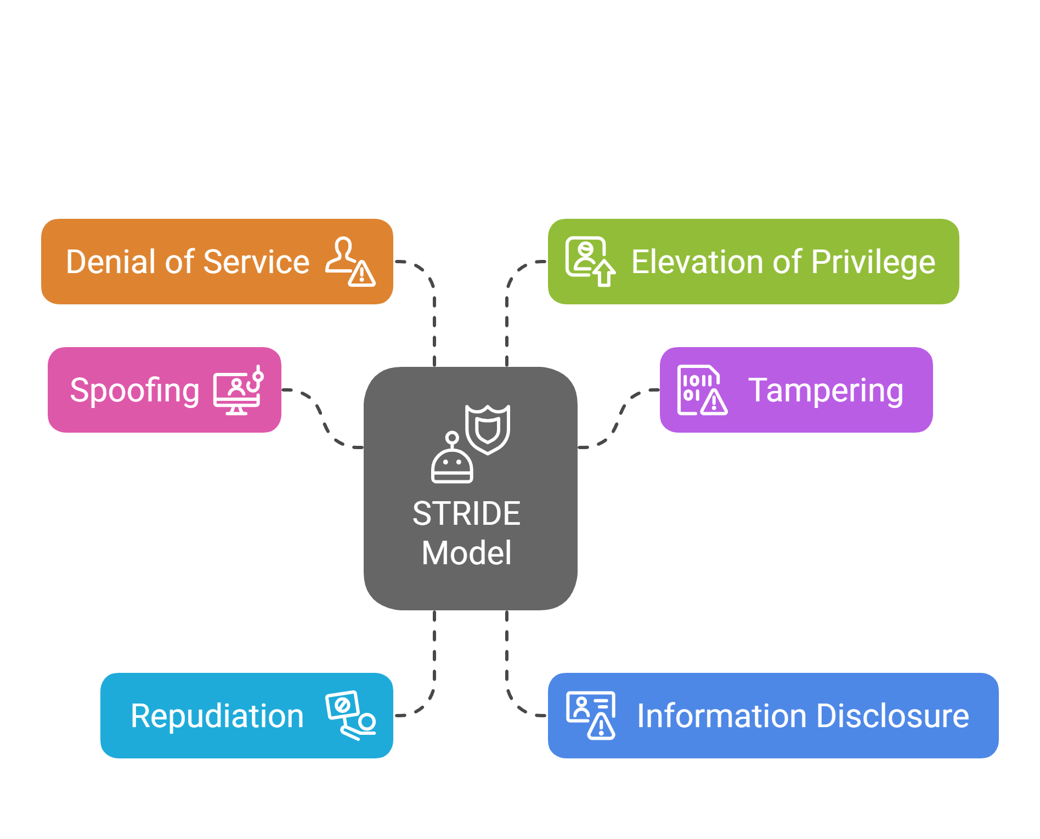
threat modelling strategies - stride
Virtualization
Notes:
The STRIDE threat model is a framework used in cybersecurity to systematically identify and assess potential threats to systems.
It categorizes threats into six types: Spoofing, Tampering, Repudiation, Information Disclosure, Denial of Service, and Elevation of Privilege.
This categorization helps security professionals and developers to think more comprehensively about what could go wrong in a system and how to address those risks.
Spoofing: Impersonating another user or entity to gain unauthorized access or perform actions.
Tampering: Unintentionally or maliciously modifying data or system configurations.
Repudiation: Denying that an action was performed, even though it can be proven to have occurred.
Information Disclosure: Exposing sensitive data to unauthorized individuals or entities.
Denial of Service (DoS): Making a service unavailable to its intended users by overwhelming it with traffic or exploiting vulnerabilities.
Elevation of Privilege: Gaining unauthorized access to higher system privileges or capabilities.
STRIDE is often used in conjunction with other threat modeling techniques and tools, such as data flow diagrams, to provide a more thorough analysis of potential vulnerabilities. It helps developers and security experts identify potential threats and vulnerabilities early in the development process, allowing them to address those issues before they are exploited by attackers. STRIDE is often used in conjunction with other threat modeling techniques and tools, such as data flow diagrams, to provide a more thorough analysis of potential vulnerabilities. It helps developers and security experts identify potential threats and vulnerabilities early in the development process, allowing them to address those issues before they are exploited by attackers. Explain each STRIDE category with simple examples relevant to the sample application. For instance, in the shopping cart, spoofing could be someone pretending to be a user to make unauthorized purchases, mitigated by implementing multi-factor authentication. Discuss how tampering, like modifying product prices, can be prevented by validating inputs and using parameterized queries. Highlight the importance of logging for repudiation to ensure accountability.

Slide 9
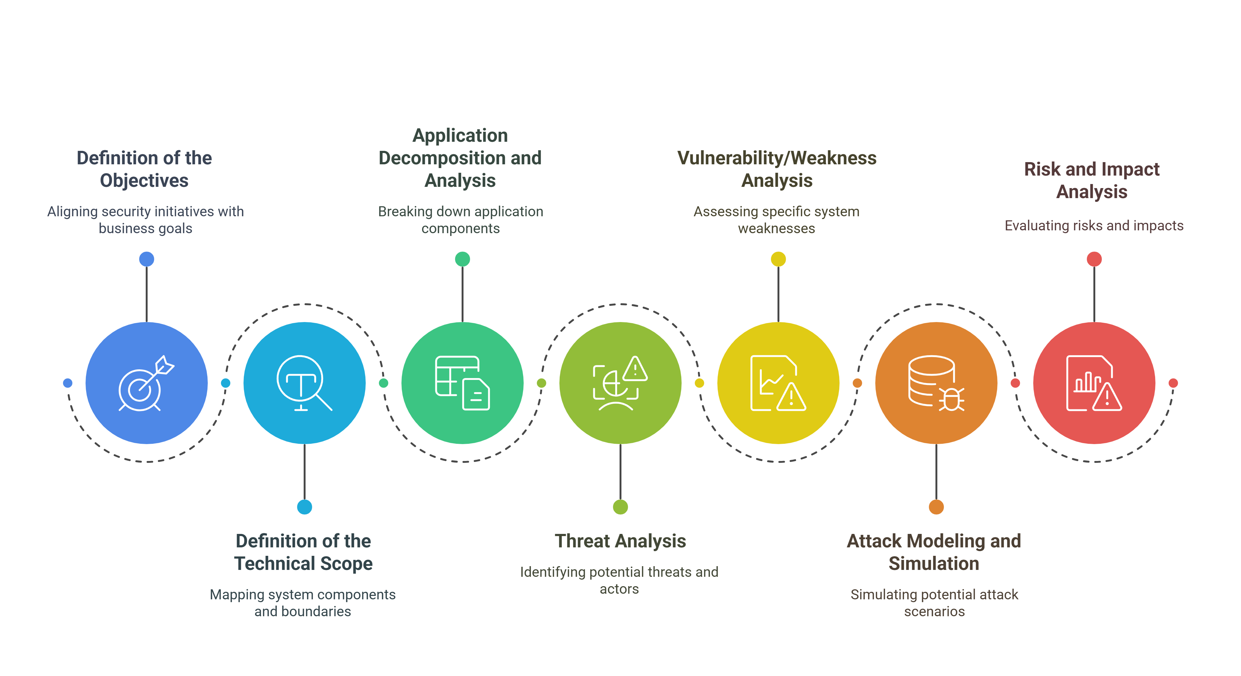
threat modelling strategies - pasta
Virtualization
https://versprite.com/blog/what-is-pasta-threat-modeling/
Notes:
PASTA framework introduction: Process for Attack Simulation and Threat Analysis, a seven-stage methodology.
Steps of PASTA: Define objectives, gather intelligence, decompose the application, analyze threats, design controls, verify and prioritize, maintain and iterate. Comparing different methodologies: STRIDE vs. PASTA, where STRIDE focuses on threat categories and PASTA is more comprehensive with risk assessment.
Selecting the appropriate methodology: Based on project complexity, team expertise, and specific needs. Tools for threat modeling: Microsoft Threat Modeling Tool, IriusRisk, etc., aiding in structured analysis.
https://www.purestorage.com/knowledge/pasta-threat-modeling.html https://threat-modeling.com/pasta-threat-modeling/ Explain that PASTA provides a more detailed framework, suitable for complex systems or when a thorough risk assessment is needed. For this course, we'll focus on STRIDE for its simplicity and effectiveness in identifying threats. Mention tools like Microsoft Threat Modeling Tool for structured analysis, and encourage exploring IriusRisk for advanced needs. Discuss how to choose based on project scope, like using STRIDE for quick assessments and PASTA for detailed analysis.

Slide 10

Risk assessment basics
What is risk assessment in security?
Evaluating the likelihood and impact of potential security threats.
Components:
Assets (what needs protection),
threats (potential attackers or events),
vulnerabilities (weaknesses in the system),
controls (security measures in place).
Risk calculation formula: Risk = Likelihood × Impact. Methods for assessing:
Qualitative (high, medium, low)
Quantitative (numerical values).
Importance: Helps prioritize which threats to address first based on their risk level.
Virtualization
Notes:
Explain that risk assessment helps in understanding which threats are most critical and need immediate attention. Discuss how to define likelihood and impact scales appropriately for the context, using qualitative methods for simplicity in this course. Highlight the importance of prioritizing based on risk level to allocate resources effectively, especially in resource-constrained environments.

Slide 11
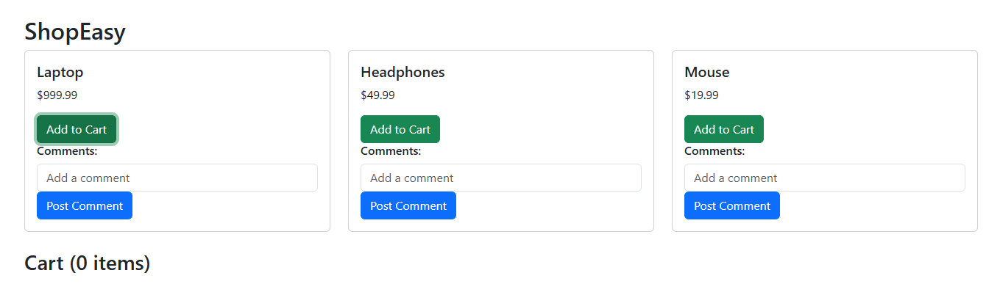
Sample application
Virtualization
Objective: Understand the "ShopEasy" application and its components.
Instructions: "ShopEasy" is an online shopping cart application with a React frontend, Python Flask backend, and MySQL database.
It allows users to browse products, add items to a cart, and checkout using credit card information.
The application has been intentionally designed with vulnerabilities (e.g., SQL injection, XSS, insecure password storage) for educational purposes.
Why It Matters: Knowing the application's structure helps identify where security risks may arise.
Notes:
Potential security concerns: SQL injection, XSS, insecure credit card storage, weak password policies, no two-factor authentication, no rate limiting.
Why chosen: Common vulnerabilities typical in e-commerce applications, suitable for demonstration. Learning objectives: Practice threat modeling and risk assessment techniques on a relatable application.

Slide 12
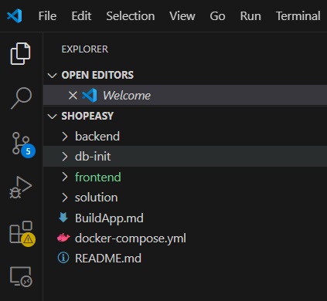
Setting up the environment
Objective: Get the "ShopEasy" application running.
Instructions:
Option 1: Build from Scratch
Clone the repository: git clone <repository-url>
Set up the database: Run database.sql in MySQL.
Install frontend dependencies: cd frontend && npm install
Install backend dependencies: cd backend && pip install -r requirements.txt
Start the backend: python app.py
Start the frontend: npm start
Option 2: Use Docker
Ensure Docker and Docker Compose are installed.
Run docker-compose up --build to start all services.
Access the frontend at http://localhost:8080.
Virtualization

Slide 13
APPLY threat modelling to “shop easy”
Identify Assets: List key assets (e.g., user data, payment information, product database).
Brainstorm Threats Using STRIDE:
Spoofing: Could an attacker impersonate a user to make unauthorized purchases?
Tampering: Could an attacker modify product prices or order details?
Repudiation: Could a user deny making a purchase?
Information Disclosure: Could sensitive data (e.g., credit card info) be exposed?
Denial of Service: Could the application be overwhelmed to make it unavailable?
Elevation of Privilege: Could a user gain admin access?
Document Threats: Create a list of potential threats for each STRIDE category.
Virtualization

Slide 14
Risk assessment
Instructions:
Define Likelihood and Impact Scales:
Likelihood: Low (rare), Medium (possible), High (frequent).
Impact: Low (minor), Medium (moderate), High (severe).
Assess Each Threat:
For example:
SQL Injection (Tampering): Likelihood = High, Impact = High.
Weak Password Storage (Spoofing): Likelihood = Medium, Impact = High.
Use a Risk Matrix: Plot threats on a matrix to categorize them (e.g., High Risk, Medium Risk, Low Risk).
Why It Matters: Risk assessment helps prioritize which threats to address first based on their potential impact.
Virtualization

Slide 15

Prioritizing risks
Objective: Determine which risks to address first.
Instructions:
Prioritization Criteria: Focus on threats with high likelihood and high impact.
Example:
High Priority: SQL injection, XSS, insecure password storage.
Medium Priority: Lack of rate limiting.
Low Priority: Minor UI issues.
Why It Matters: Prioritization ensures that critical security issues are addressed with the available resources.
Virtualization

Slide 16

Create actionable security plans
Objective: Develop plans to mitigate prioritized risks.
Instructions:
For Each High-Priority Risk:
SQL Injection: Implement parameterized queries or ORM.
XSS: Sanitize user inputs and use Content Security Policy (CSP).
Insecure Password Storage: Use hashing with salt (e.g., bcrypt).
Why It Matters: Actionable plans ensure that security is embedded into the development process, not bolted on later.
Virtualization

Slide 17
Integrate security into devsecops
Static Code Analysis
Integrate tools like SonarQube or Bandit in CI/CD pipelines
Detect code vulnerabilities early in the development process
Dynamic Security Testing
Use OWASP ZAP for automated scans during staging
Identify runtime vulnerabilities before production
Dependency Scanning
Implement tools like Dependabot or Snyk
Monitor third-party libraries for known vulnerabilities
Documentation
Develop and maintain a Security Playbook
Define mitigations, tools, and team responsibilities
Virtualization
Security Playbook
Dependabot
Monitors third-party library vulnerabilities.
Defines security protocols and responsibilities.
Early Detection
Late Detection
SonarQube
OWASP ZAP
Detects vulnerabilities early.
Identifies runtime vulnerabilities.
Notes:
Now let’s discuss how we can effectively integrate security into our DevSecOps practices. Security shouldn't be an afterthought—it needs to be embedded throughout the development lifecycle. Let's break this down into four key areas.
Static Code Analysis First, we have static code analysis. This is our first line of defense. By using tools like SonarQube or Bandit, we can scan our code for vulnerabilities before it even runs. These tools help us catch issues like insecure coding patterns or logic flaws early in the development cycle. The key here is integration. These tools should be baked right into the CI/CD pipeline, so that every code commit is automatically analyzed. This ensures we’re constantly validating the security posture of our source code as it's written.
Dynamic Security Testing Next, we need to think about how the application behaves at runtime. That’s where dynamic testing comes in. Tools like OWASP ZAP allow us to simulate attacks and look for vulnerabilities like SQL injection or cross-site scripting in a running application.
By automating these scans during the staging phase, we can catch threats that wouldn’t appear in static analysis—things like misconfigured endpoints or insecure authentication flows.
Dependency Scanning Third, we address one of the most overlooked attack surfaces: our dependencies. Most of our applications rely heavily on open-source packages. These are great for productivity, but they also bring risks. Using tools like Dependabot or Snyk, we can continuously monitor those packages for known vulnerabilities and get alerted when updates or patches are available. This helps us stay secure without slowing down development.
Documentation Finally, none of this matters without good documentation. We need a well-maintained security playbook that outlines:
Which tools we use
What threats we’re mitigating
And who’s responsible for what This keeps everyone on the same page—from developers to security engineers—and ensures consistent responses to security events.

Slide 18
Hands on exercise:
Objective: Apply learned concepts to secure the login functionality of "ShopEasy."
Instructions:
Task: Secure the login functionality against SQL injection and implement frontend input validation.
Steps:
Backend Fix:
Locate the vulnerable login code in backend/app.py.
Modify the code to use parameterized queries to prevent SQL injection.
Test the fix by attempting an SQL injection attack (e.g., entering ' OR '1'='1 as the password).
Frontend Enhancements: Implement input validation in the login form to ensure:
Username is between 3 and 50 characters.
Password is between 6 and 50 characters.
Use a configurable API URL via environment variables (e.g., process.env.REACT_APP_API_URL) to ensure secure and flexible API calls.
Virtualization
Notes:
This exercise provides hands-on practice in securing both backend and frontend components, reinforcing theoretical knowledge and building confidence in applying comprehensive security measures in DevSecOps.

Slide 19
What is the primary purpose of threat modeling in DevSecOps?
a) To automate security testing in CI/CD pipelines b) To identify and prioritize potential security threats early in development c) To encrypt sensitive data stored in the database d) To monitor application performance in production

Slide 20
What is the primary purpose of threat modeling in DevSecOps?
a) To automate security testing in CI/CD pipelines b) To identify and prioritize potential security threats early in development c) To encrypt sensitive data stored in the database d) To monitor application performance in production
Notes:
Threat modeling is a structured approach to proactively identify and prioritize security threats, enabling teams to address vulnerabilities early in the development lifecycle, aligning with the "shift left" principle of DevSecOps.

Slide 21
In the "ShopEasy" application, what vulnerability makes the login functionality susceptible to SQL injection?
a) Direct string concatenation in SQL queries
b) Use of parameterized queries c) Hashing passwords with bcrypt d) Input sanitization in the frontend

Slide 22
In the "ShopEasy" application, what vulnerability makes the login functionality susceptible to SQL injection?
a) Direct string concatenation in SQL queries
b) Use of parameterized queries c) Hashing passwords with bcrypt d) Input sanitization in the frontend
Notes:
The "ShopEasy" backend uses string concatenation (e.g., f"SELECT * FROM users WHERE username = '{username}'") in SQL queries, allowing attackers to inject malicious SQL code, such as ' OR '1'='1.

Slide 23
Which mitigation addresses the XSS vulnerability in the "ShopEasy" frontend’s comment section?
a) Using HTTPS for API calls b) Implementing parameterized queries c) Sanitizing comments with DOMPurify d) Adding rate limiting to the backend

Slide 24
Which mitigation addresses the XSS vulnerability in the "ShopEasy" frontend’s comment section?
a) Using HTTPS for API calls b) Implementing parameterized queries c) Sanitizing comments with DOMPurify d) Adding rate limiting to the backend
Notes:
The frontend’s use of dangerouslySetInnerHTML allows XSS attacks. Sanitizing comments with a library like DOMPurify removes malicious scripts, preventing code execution.

Slide 25

Individual key takeaways
Write down three key insights from today’s session.
Highlight how these take aways influence your work.

Slide 26

Q&A and open discussion
Notes:
Now is the time to engage in an interactive Q&A session where you can ask questions, share insights, and clarify any doubts about the topics we have covered so far.
This open discussion is designed to ensure that every participant has the opportunity to voice their thoughts and learn from the collective experience of the group.
Your questions and comments are valuable as they help us identify areas that may need further explanation and enable us to tailor future sessions to your needs.
We encourage you to speak up and contribute to the dialogue, as this interaction is one of the key components of our interactive learning approach.
As the session progresses, take note of any questions or ideas that you would like to revisit, and feel free to share your perspectives with the class.

Slide 27

Kiali distributed tracing (Jaeger)

